Slide 1

Pulse-Inverted Electrolyzer – Capstone Team 3
Brennan Angus, Matthew Beausoleil, Jacob Cooper, Wyatt Groves, Austin Jerrolds, Conner Sanders

Slide 2
The Problem is
The goal of the project was to create a water electrolysis system with modifications intended to boost its energy efficiency.
Modifications were also made to the base system to properly address public health risks associated with the project and comply with various safety standards.

Slide 3
Standards
1910.103 OSHA – Storage, handling, and transportation
NFPA 2 – Hydrogen Technolgies Code
NFPA 54 – National Fuel Gas Code
NFPA 70 – National Electrical Code
ANSI Z21.1 - American National Standards Institute

Slide 4
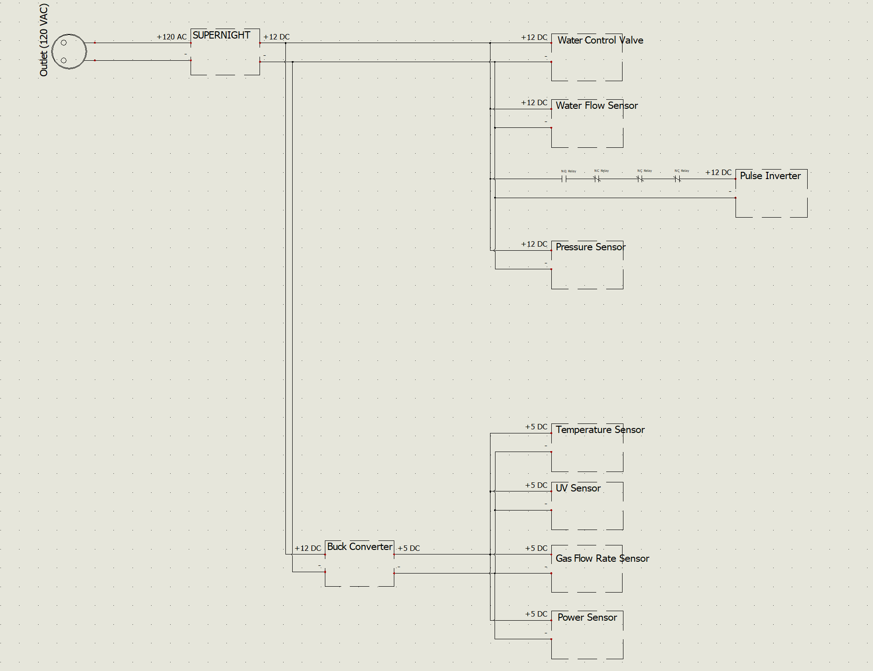
Design - Power
What needs power?
The biggest power draw is the electrolysis cell itself.
When DC, it will draw around 240 watts.
To draw the 5 volts needed, a buck converter was used.

Slide 5
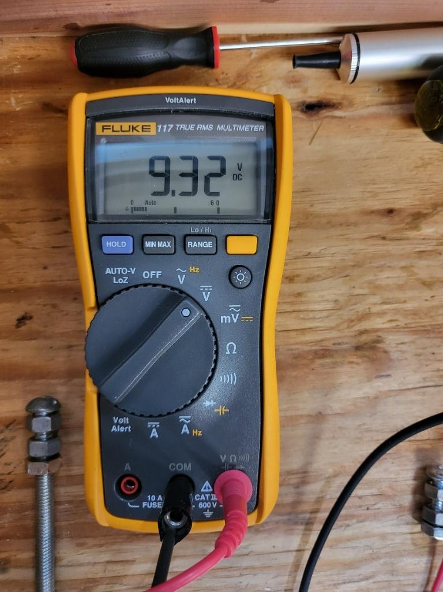
Implementation - Power
Implementation is straightforward – just use a bus-bar.
The biggest challenge was finding wire sizes for DC testing.
The DC cell draws so much power it starts to lower the output of the supply.

Slide 6
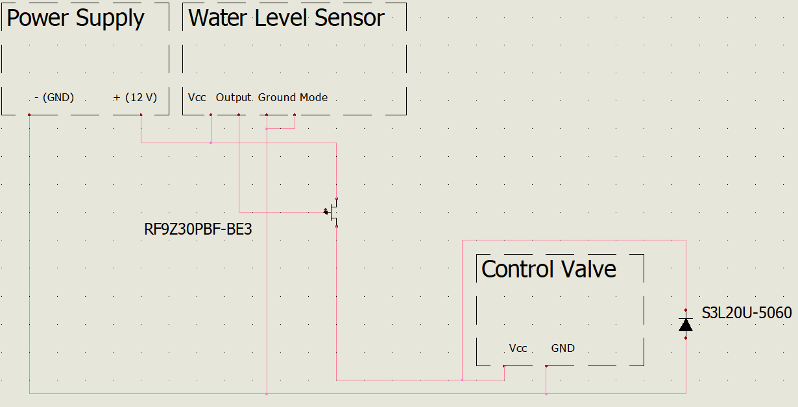
Design - Water
Needed a way to sense the level of the Water level without being in the cell
Had to ensure the was no backflow to make sure we would not contaminate the water supply
Had make sure the water would stay at an appropriate level

Slide 7
Implementation - Water
Original Design did not work
Needed to invert the signal from the sensor
Could have used a micro-controller but went with an analog circuit

Slide 8
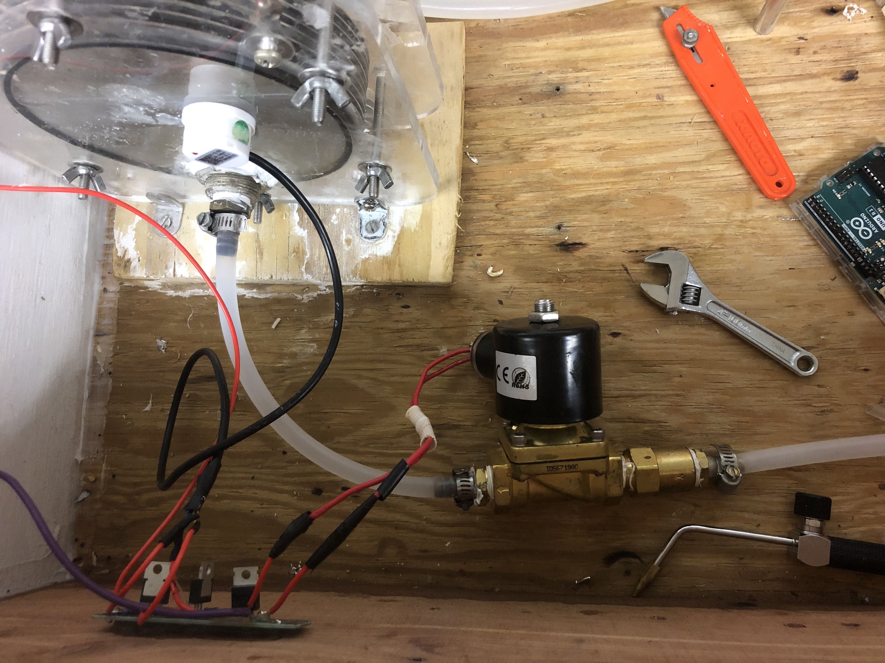
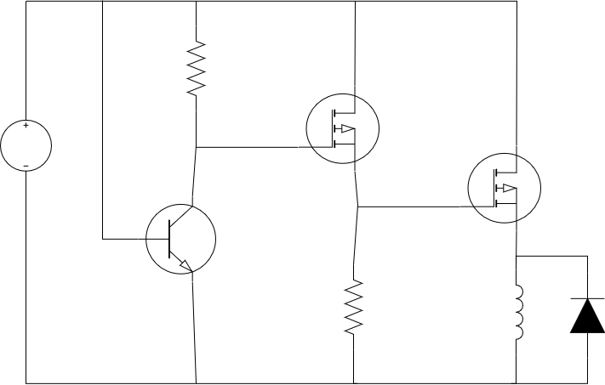
Implementation - Water

Slide 9
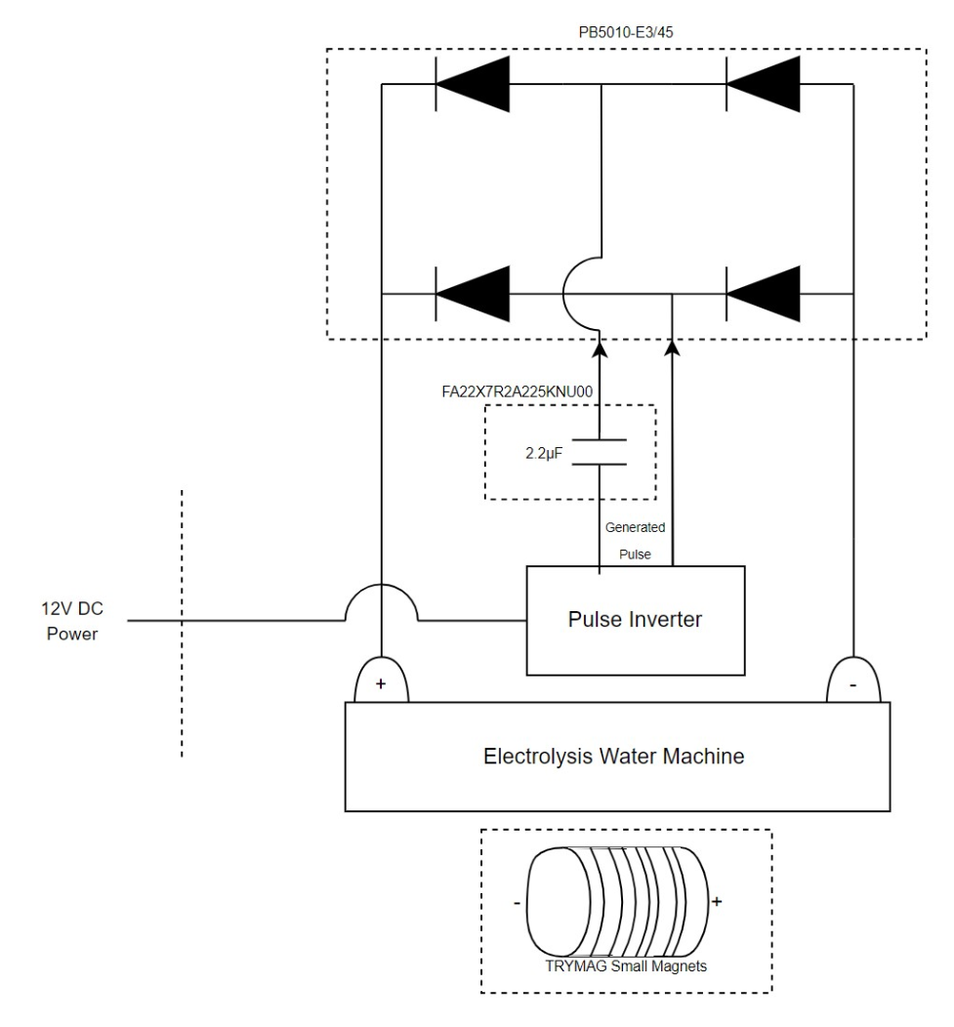
Design - Electrolysis
Needs to include the electrolytic cell and the
tools for efficiency boosting
Pulse inverter
Rectifier
Magnets
Coupling capacitor

Slide 10
Implementation - Electrolysis
Everything was incorporated successfully.
The expected AC pulses were produced from the pulse inverter.
The AC voltage was then rectified properly.
Magnets were attached to the outside of the cell.
The auxiliary capacitors were replaced to adjust the duty cycle of the pulses.

Slide 11
Design - Controller
Arduino Uno for sensor readings, efficiency calculations, and serial output.
Originally planned on using the SFM3003 for gas flow rate readings but the gas tube was too small to fit around the sensor.
Switched to FS1012 which is an analog gas flow rate sensor.
Adafruit INA260 for power readings.

Slide 12
Implementation - Controller
Accidentally desoldered resistors off the power sensor, new ones had to be ordered.
The flowrate sensor originally was reading about 7.4 sccm while using 240 Watts but after trying to solder on wires and desolder the pins the sensor no longer behaved the same way.
The power sensor was about 3-4 Watts off I think this was since the sensor was not grounded with the rest of the system.

Slide 13
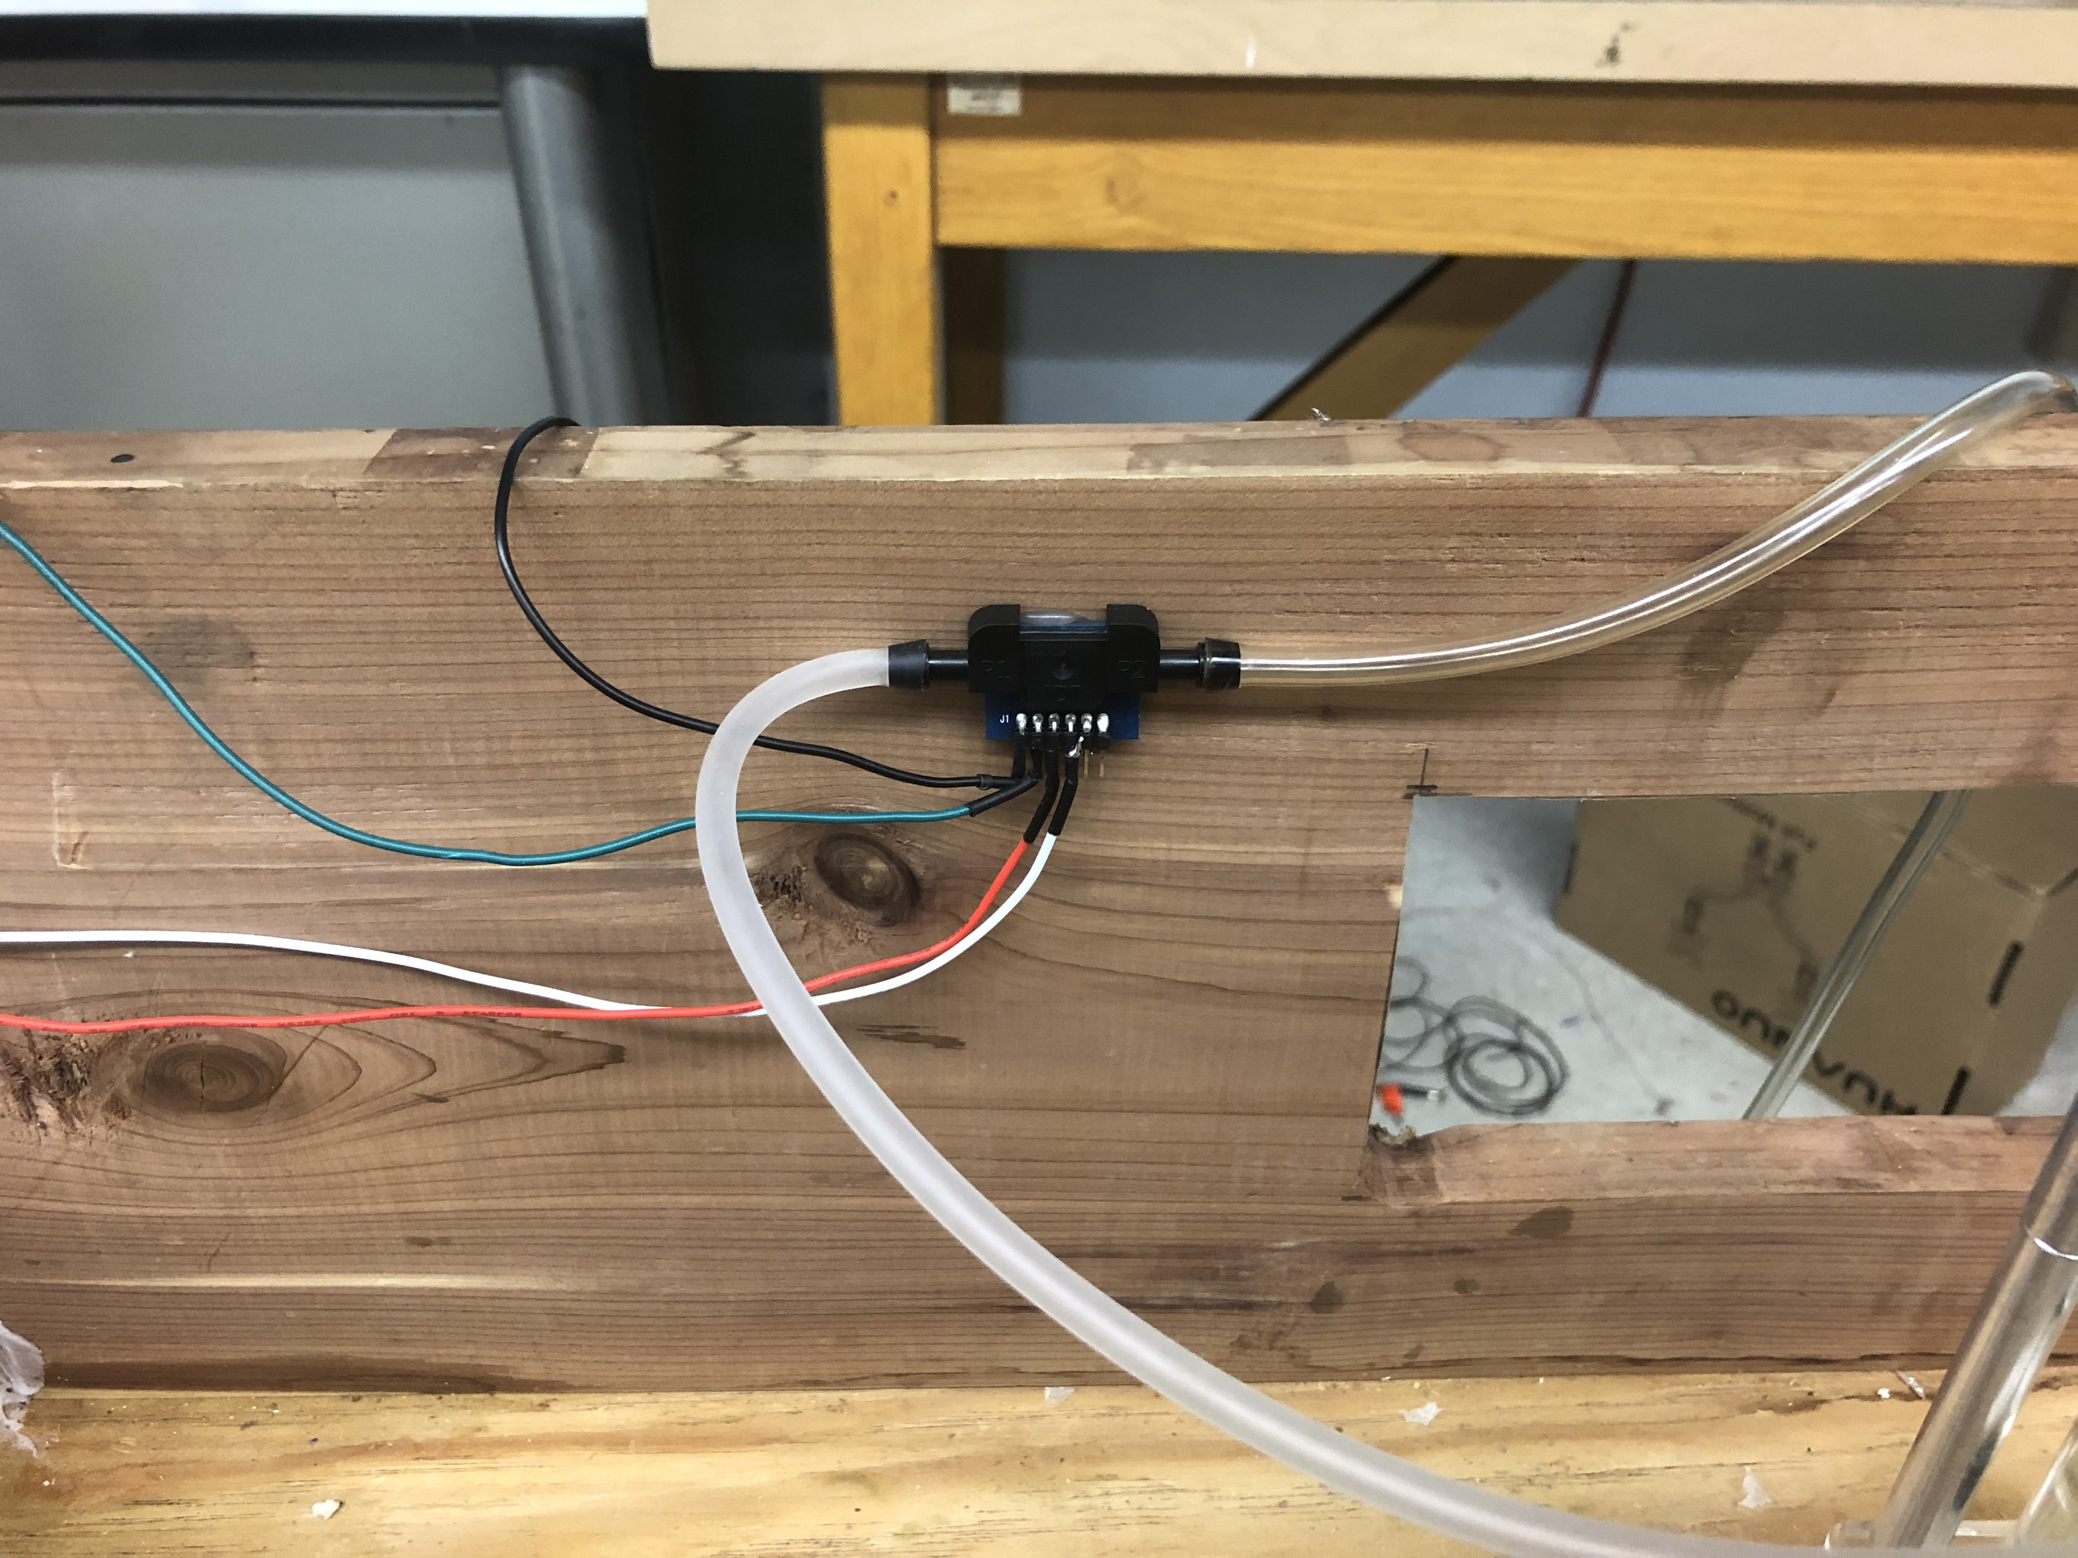
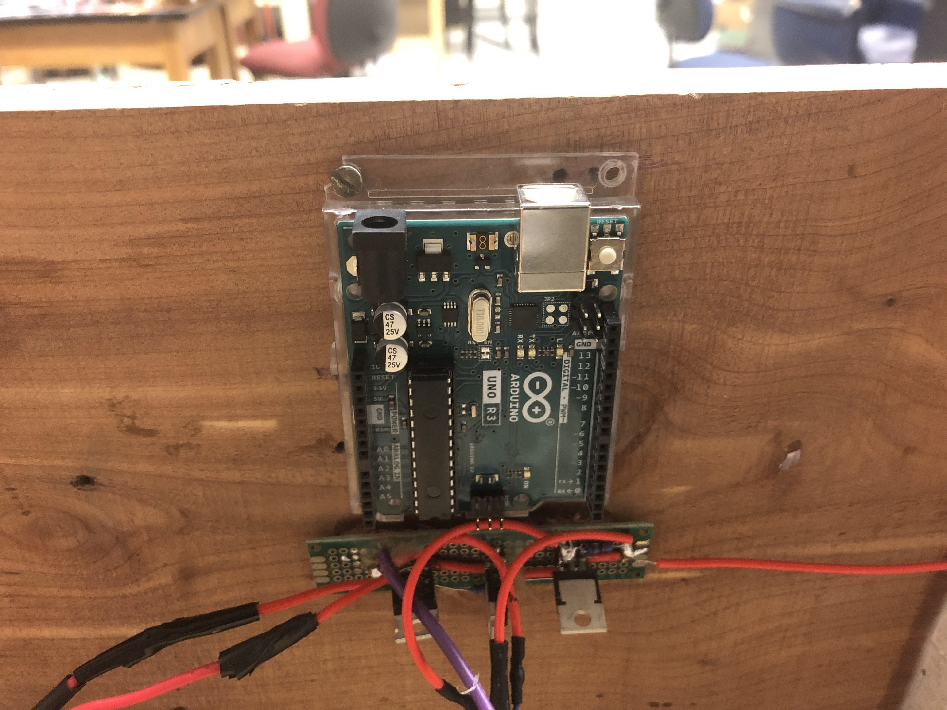
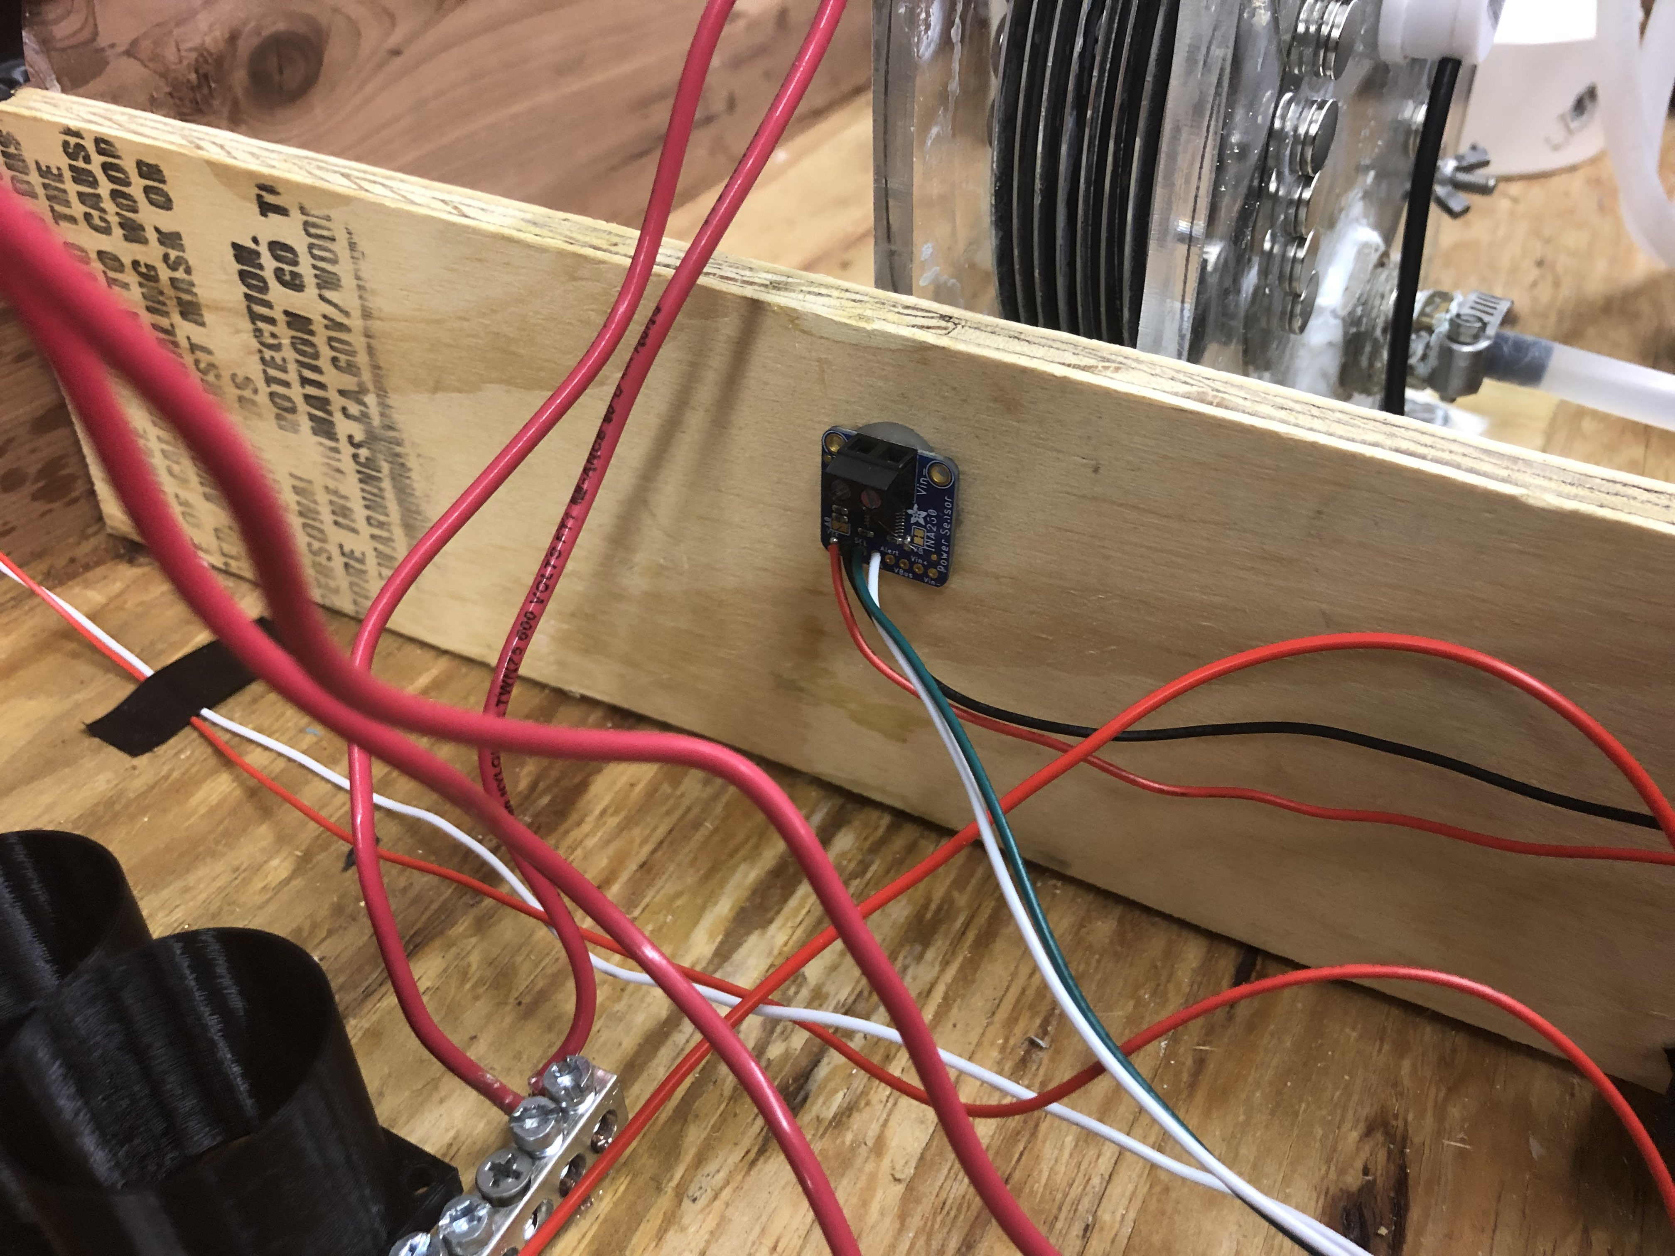
Implementation - Controller

Slide 14
Design - Gas
Handling gas once it is generated, there is no storage in the system.
Gas Arrestor is used to prevent any combustion from going back into cell housing, this is used as a safety measure.
Gas System prevents the backflow of flame from causing damage to the system

Slide 15
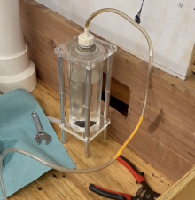
Implementation - Gas
The system was turned on, the torch was removed, and no flame was lit. After some time of gas producing the flame was then lit. This caused flame to be sent backwards towards the arrestor.
The water in the arrestor expels the flame and preventing it from travelling towards the cell.

Slide 16
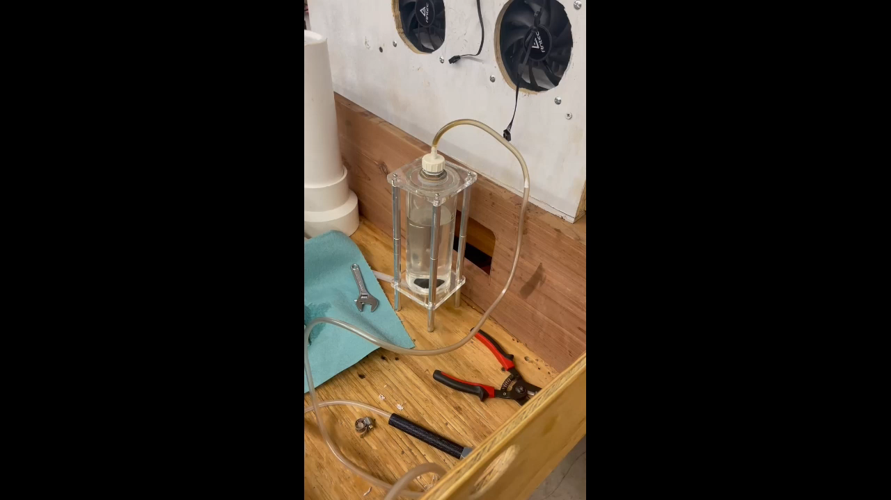
Implementation - Gas

Slide 17
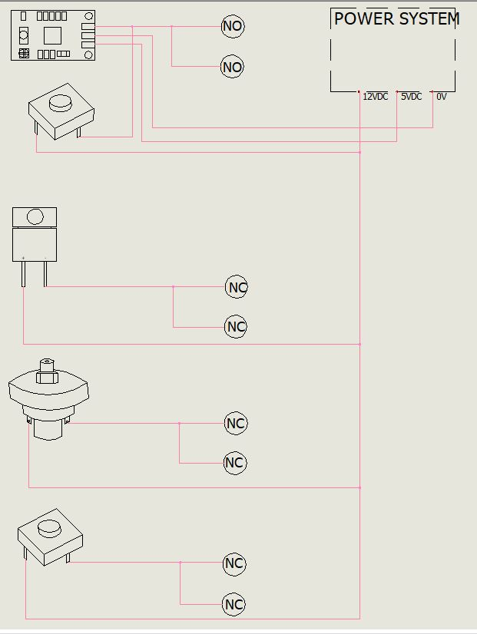
Design - Safety
Cut off power to the pulse inverter if the system becomes unsafe
"Safe" is defined by conditions in which browns gas could ignite
Temperature rises above 100 °C
Pressure builds above 15 psi
Design also includes user inputs to start/stop the system
System is not producing a flame
User presses the emergency stop button

Slide 18
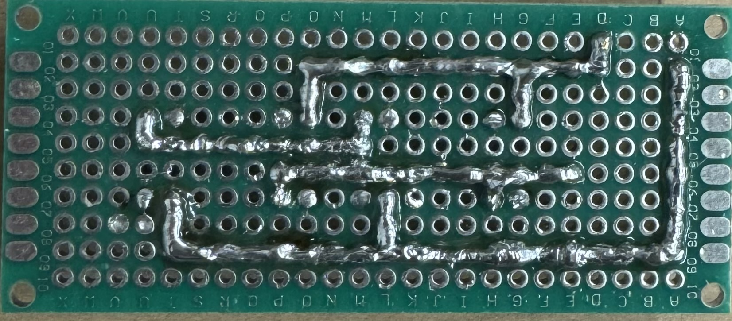
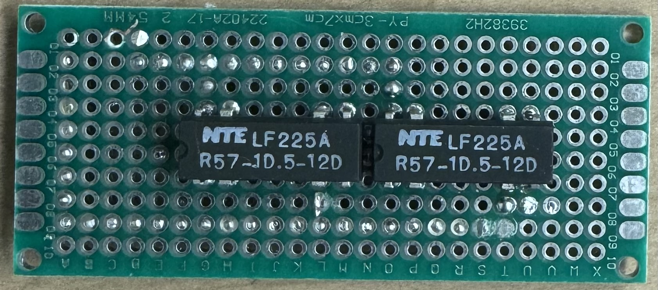
Implementation - Safety
Original flame sensor was supposed to detect light between 200-370 nm - this was not the case. A second temperature sensor was used instead.
All other components behaved as expected and implementations went smoothly.

Slide 19
Experimentation
One of our measures of success was to improve the efficiency of electrolysis.
The other measure of success we wanted to do was have a constant flame output.
To be able to measure the input and output power of the system.
The accuracy of the pulse generator outputs frequency voltage

Slide 20
What's Next?
We would like to increase the auxiliary capacitor.
Implement a closed-loop feedback system for the pulse inverter's controller.
We would like to change both the power input sensor and the gas output sensor.
We would like a high sensor and low sensor for the water system.
Use a flame sensor instead of a temperature sensor to detect flame output.

Slide 21
Budget
Predicted Real
Components | Price($)
Electrodes | 180
Pulse Generator | 90
Mini Compressor | 400
Hydrogen Sensor | 65
Housing System | 80
Gas System | 260
Micro-controller | 30
Total | 925
Components | Price($)
Controller | 155.72
Electrolysis | 120.9
Gas | 157.42
Power | 33.97
Safety | 152.64
Total | 620.65

Slide 22

Demonstration

